Slide 1
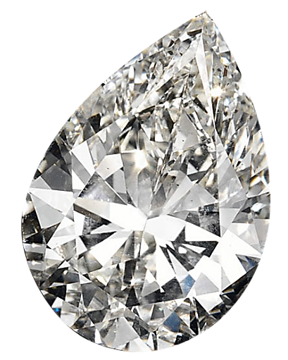
GROUP PROJECT DIAMOND PRICES Pears, 1.00 – 1.49ct
By:
Pichsinee Kalklod, Anh Phuong Ta, Minhua He, Hieu Phung Tran

Slide 2
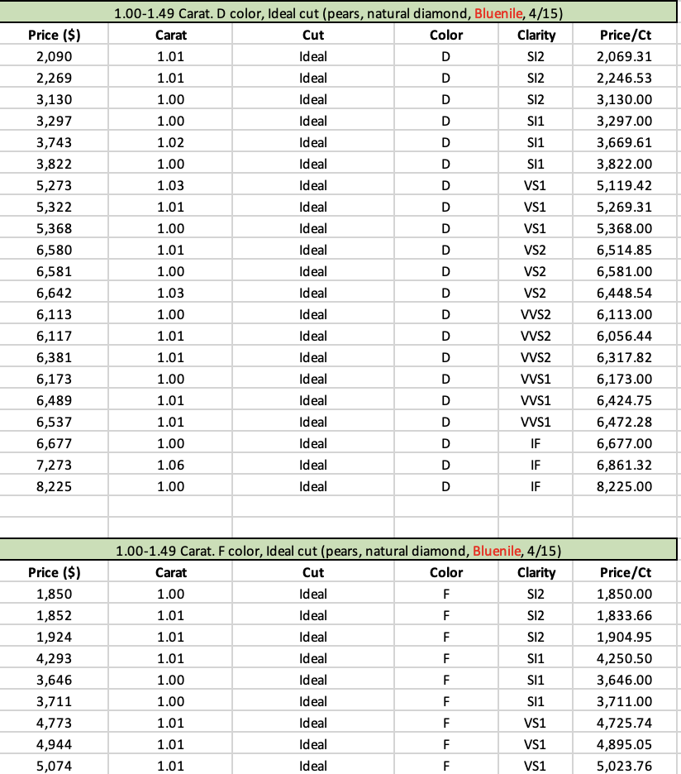
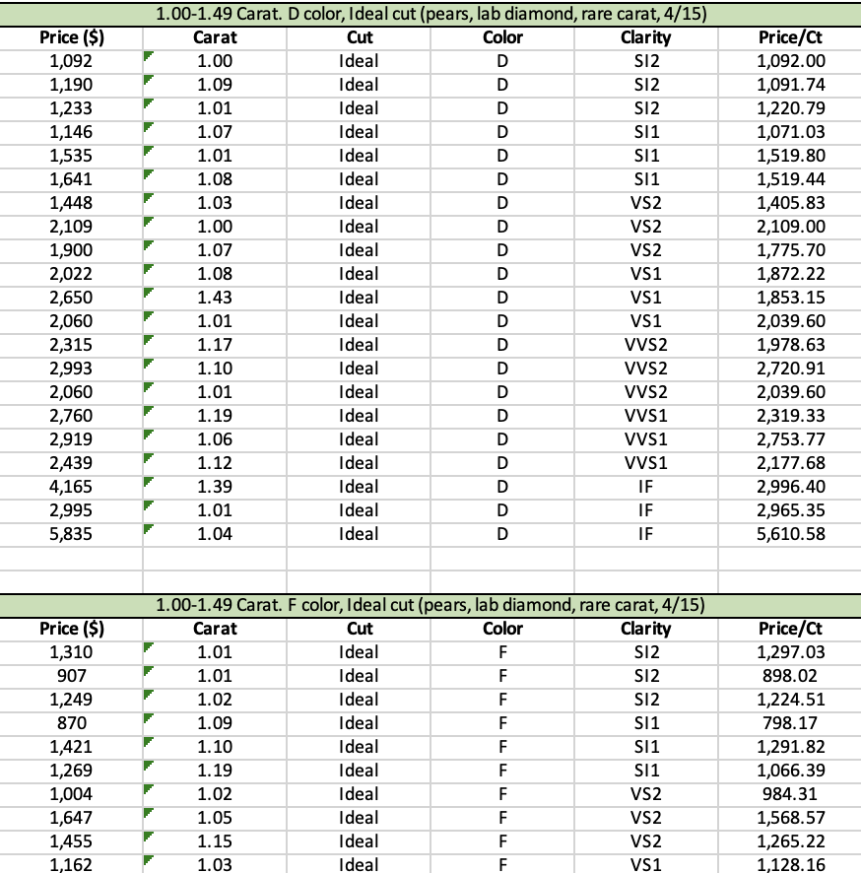
Data Acquisition
Collecting raw data
Natural and Synthetic (Lab made) diamond which are collected with Pears diamond shapes. Color from D to K; Clarify from IF to S12; 1.00 to 1.49 Ideal cut

Slide 3
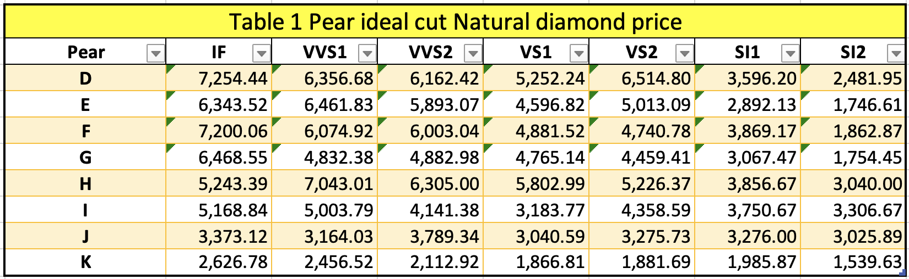
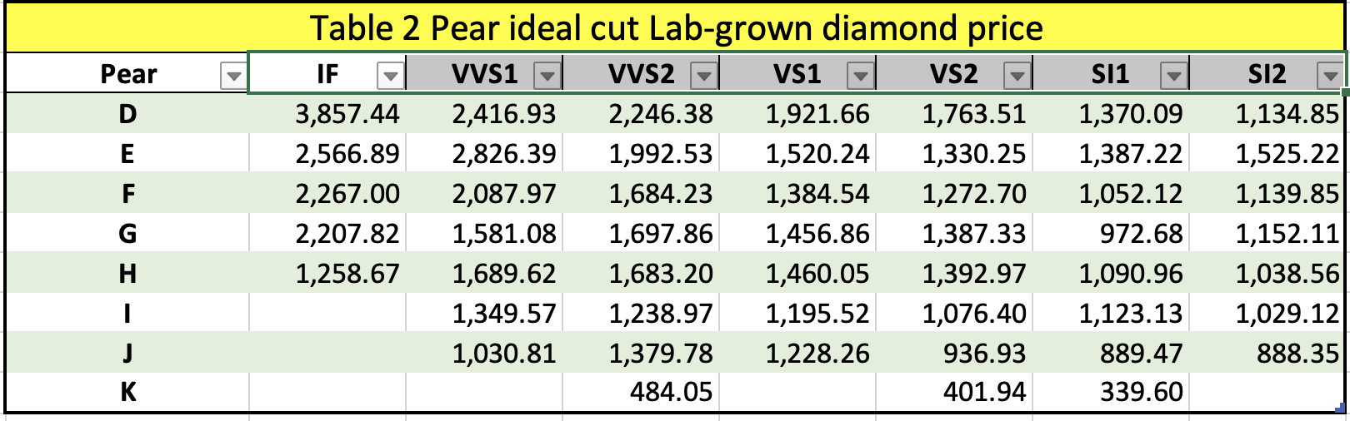
Data Summary
Develop two tables to describe the cross-sectional data of natural diamond and lab made diamond.

Slide 4
Data Summary
Maximum value 7,254.44
Minimum value 1,539.63
Descriptive Analysis
&
Data Visualization
Maximum value 3,857.44
Minimum value 339.60

Slide 5
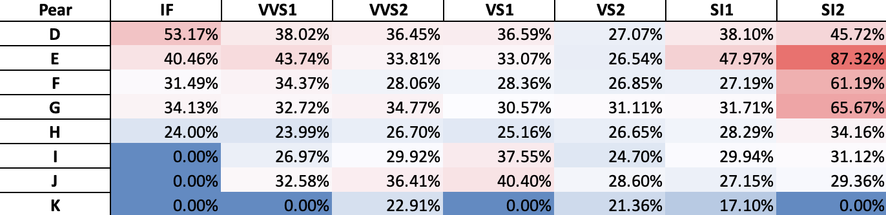
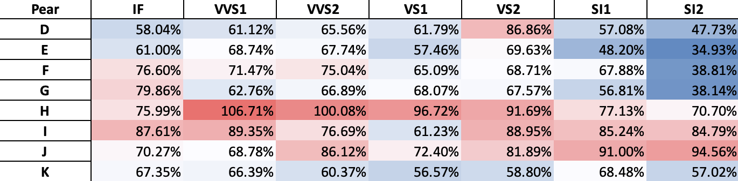
Heat map
Lab made diamond vs. natural diamond
Compare the Price/Ct
Natural diamond vs. Rapaport data

Slide 6
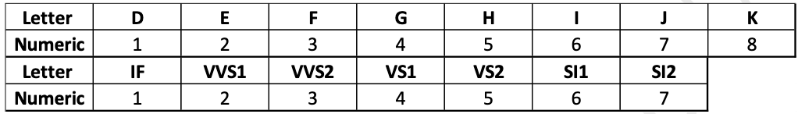
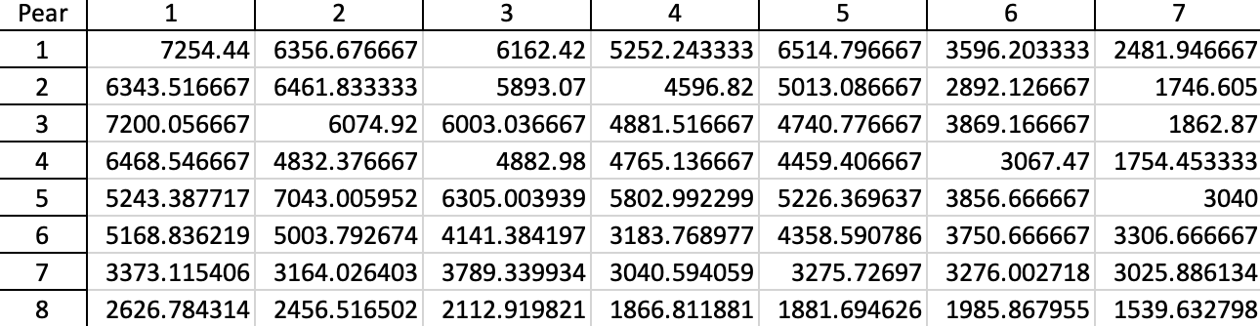
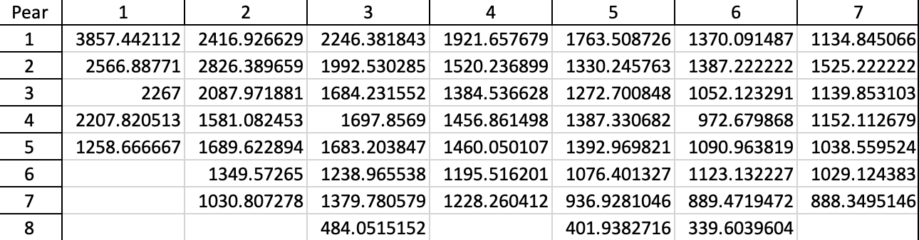
Line/scatter charts
Convert letter variables to numeric variables
Natural diamond price
Lab made diamond price

Slide 7
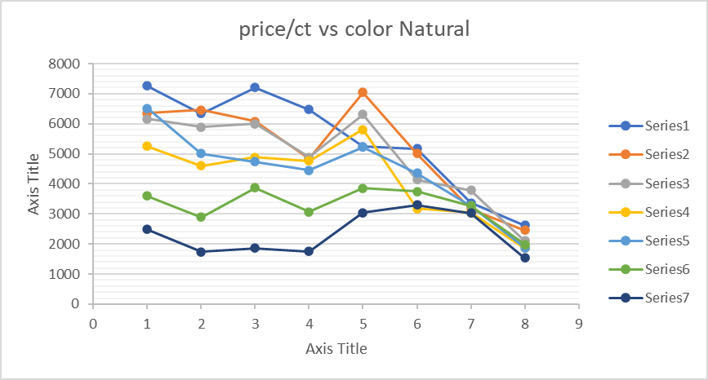
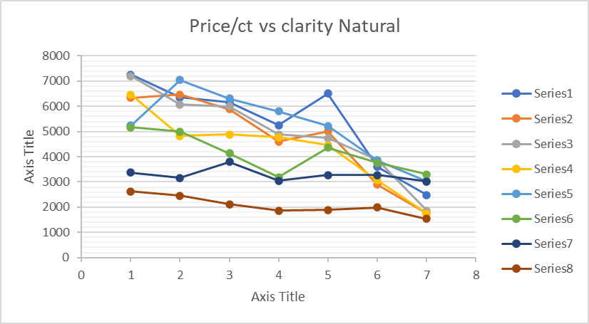
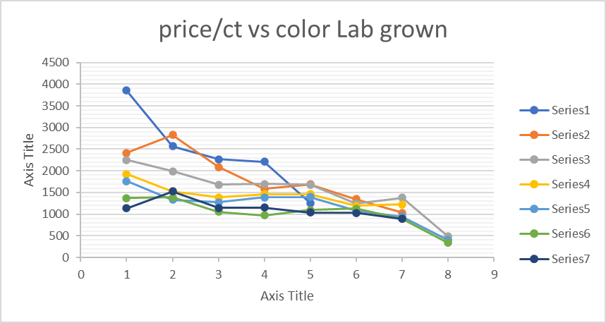
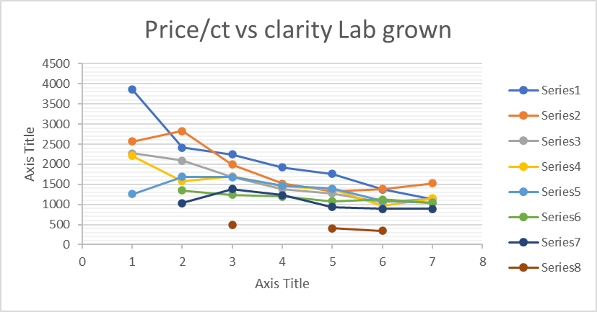
Line & Scatter Charts (combined)

Slide 8
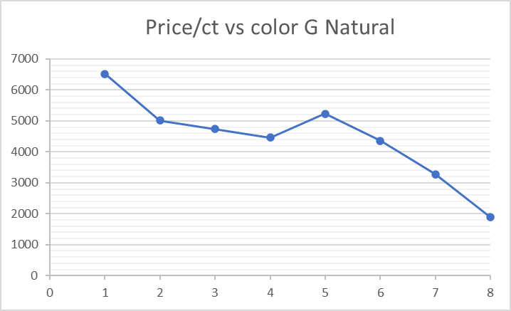
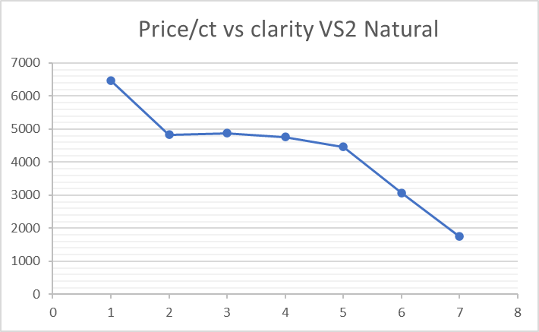
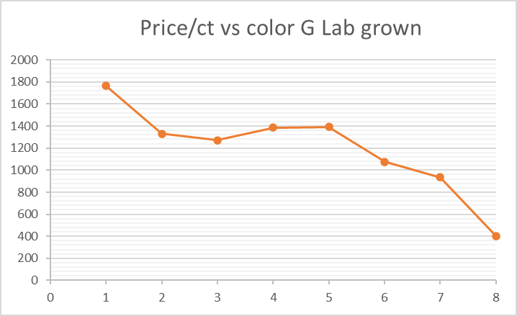
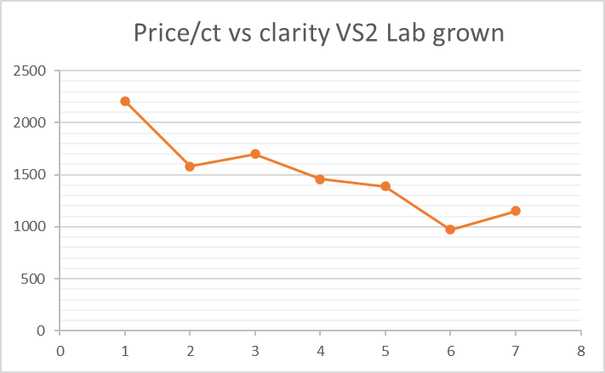
Line & Scatter Charts (for color G)

Slide 9
Regression Equation

Slide 10
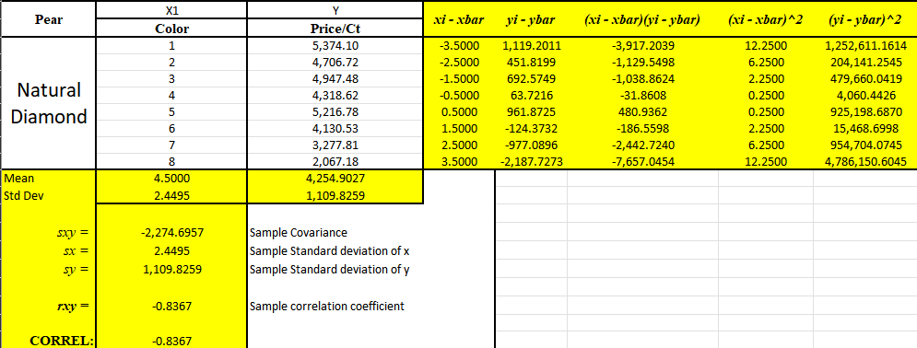
Covariance (Sxy) – Calculation for
Natural Diamond, Price/Ct vs Color (x1)

Slide 11
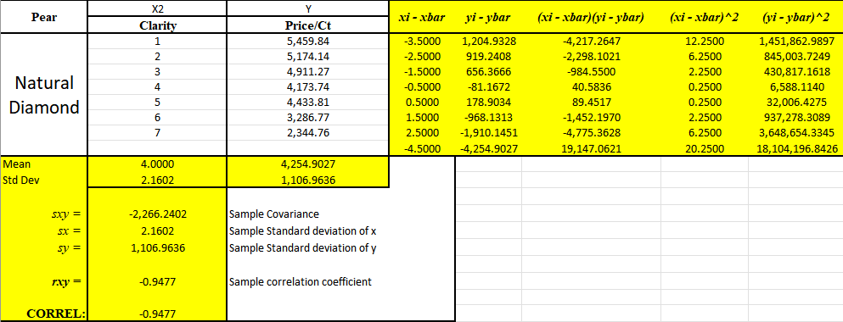
Covariance (Sxy) – Calculation for
Natural Diamond, Price/Ct vs Clarity (x2)

Slide 12
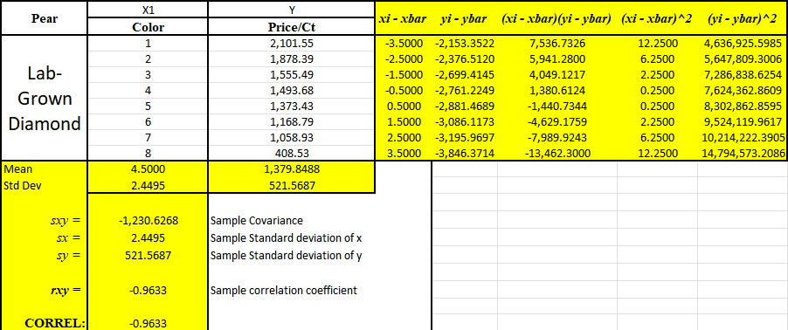
Covariance (Sxy) – Calculation for
Lab-grown Diamond, Price/Ct vs Color (x1)

Slide 13
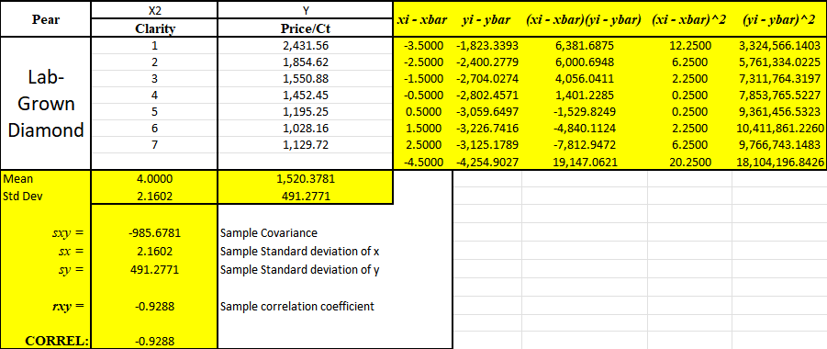
Covariance (Sxy) – Calculation for
Lab-grown Diamond, Price/Ct vs Clarity (x2)

Slide 14
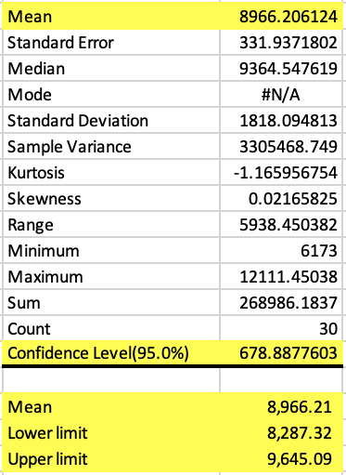
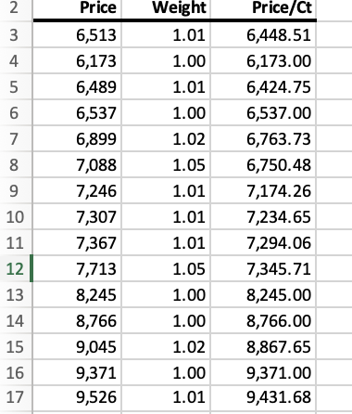
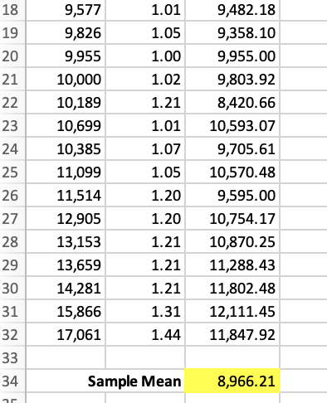
Interval estimate Natural Diamond
30 data from Natural Diamond, weight range with the other 3Cs set as color, clarity and ideal cut

Slide 15
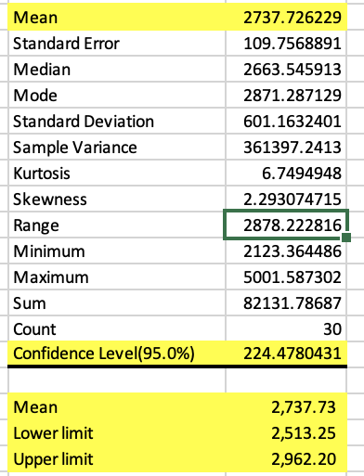
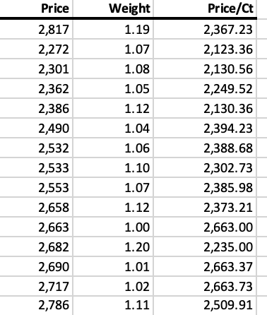
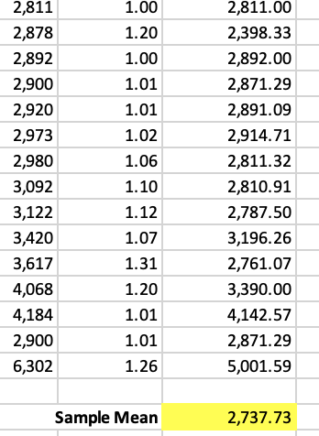
Interval estimate Lab-grown Diamond
30 data from Lab Made Diamond, weight range with the other 3Cs set as color, clarity and ideal cut

Slide 16
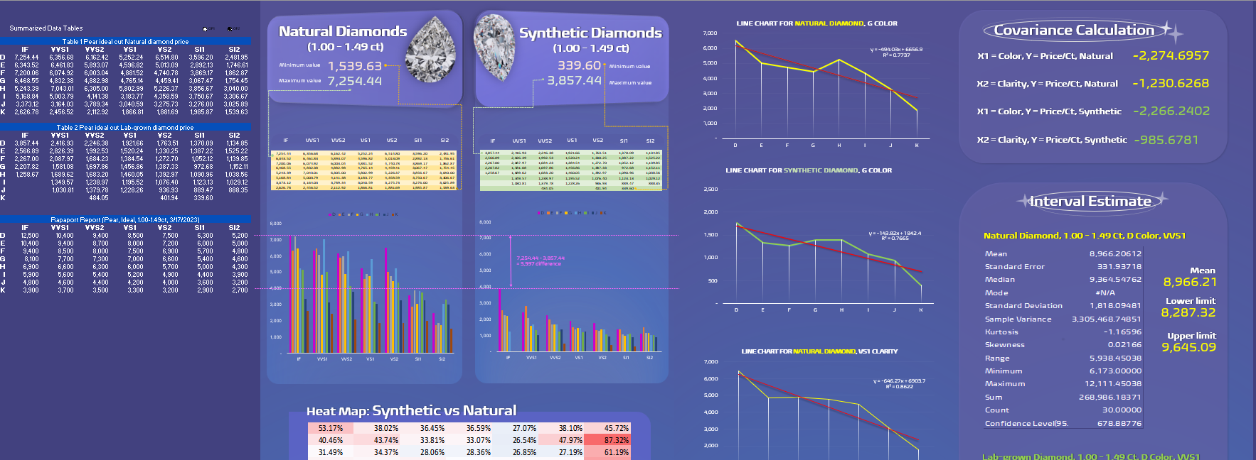
Data Dashboard

Slide 17
Conclusions
Collecting data: challenge in finding lab-grown data for more-yellow diamond with high clarity
Summarizing & comparing data: expected results
Heat map: shows that most lab-grown diamonds’ prices are only 30-40% of natural diamonds
Covariance (Sxy): calculation shows large negative covariance; inverse relationship
Interval estimate:
Natural diamond:
8,287 –> 9,645
Lab-grown diamond:
2,513 -> 2,962

Slide 18
References
https://www.bluenile.com/
https://www.brilliantearth.com/
https://www.brilliance.com/
https://www.rarecarat.com/
https://www.jamesallen.com/
https://www.stonealgo.com/
https://www.loosegrowndiamond.com/
https://www.javda.com/
https://www.adiamor.com/
https://www.rockher.com/
https://www.vrai.com/
https://www.cleanorigin.com/
https://www.grownbrilliance.com/
https://www.ritani.com/

Slide 19
Thanks!

